Slide 1

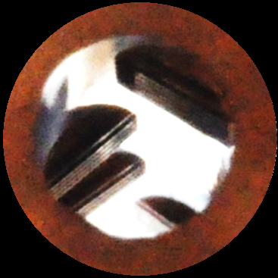
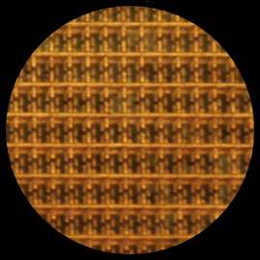
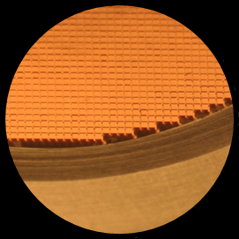
Waveguide and Metamaterial-based Quasi-Optical components for Millimetre ans Sub-millimetre Astronomy Applications
Giampaolo Pisano
Astronomy Instrumentation Group - Cardiff University
RadioNet ERATec Florence, October 5th, 2015

Slide 2
Summary
Introduction
Waveguide components
Metamaterial QO components
New QO developments

Slide 3
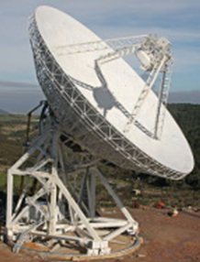
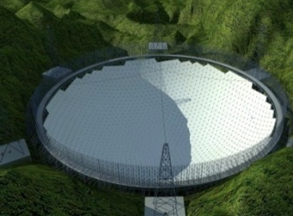
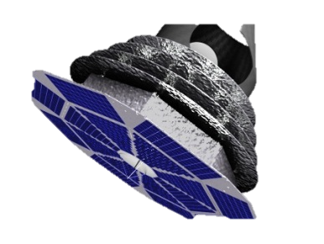
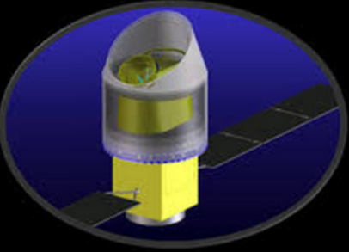
Cardiff AIG Group involvement: From Radio to THz
~1m
~3mm
1mm
~200μm
Radio
Millimetre
Sub-mm
~300MHz
~100GHz
300GHz
~1.5THz
2015
10 - 40 GHz
Quijote
QUBIC
150 GHz
(90-220)
~1 GHz
ArTemis
SRT
BINGO
NIKA2
0.6 - 1.6 THz
FAST
100 - 300 GHz
LSPE
Pilot/Blast TNG
0.3 - 115 GHz
90 – 220 GHz
0.5 – 1.2 THz /0.5 – 1.4 THz
~1 GHz
COrE+ / LiteBird
60 – 600 GHz / 60 – 280 GHz
2025?
Ground based
Balloon borne
Satellite
Notes:
etendue domaine de frequence
Strategie: collecter des donnes, developpment instrument et planification d’instruments futurs
Livraison de donnees domaine astro large (JBCA Pulsars, Cosmologie, CMB, star formation)
Differents types de contribution → intro de Planck et futurs projets

Slide 4
Astronomical instrumentation: CMB instrument example
LSPE - SWIPE instrument
Cryostat window ARC
Thermal Filters
Dielectric Lens
Rotating HWP
Thermal Filters
140, 220 & 240 GHz
Wire-grid Polariser
Stage temperatures
300K
130K
30K
2K
300mK
Band defining
Filters
Waveguide
components
Horns, OMTs,...
P. de Bernardis et al.,
Proc. SPIE v.8452 (2012)
→ All the QO components can be realised using the Mesh Technology

Slide 5
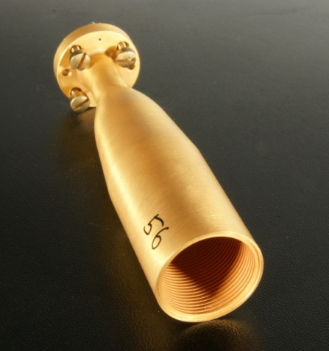
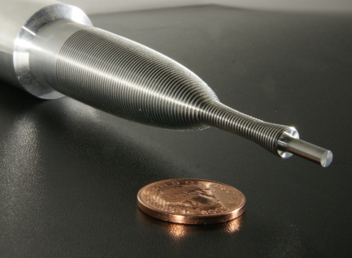
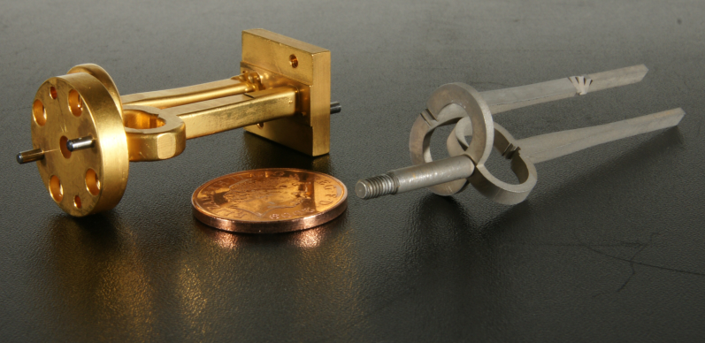
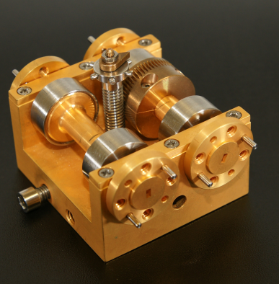
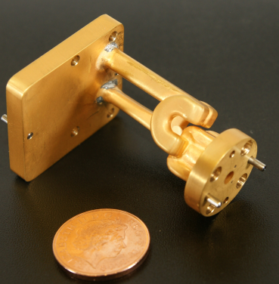
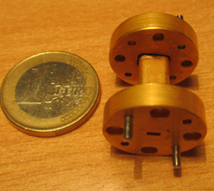
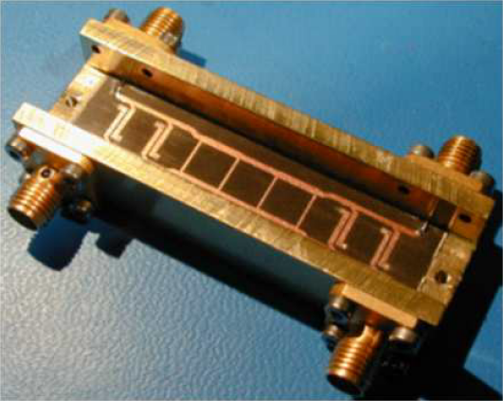
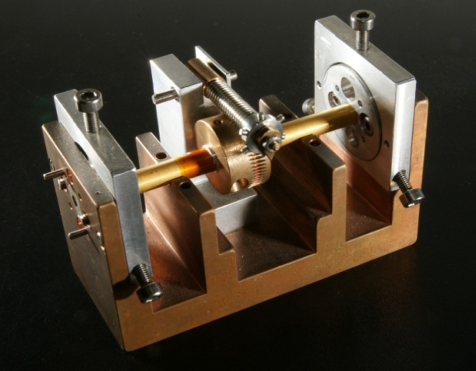
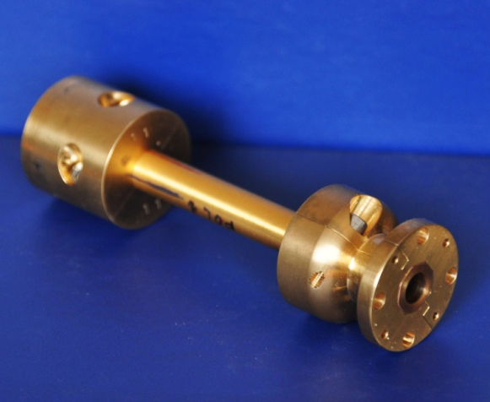
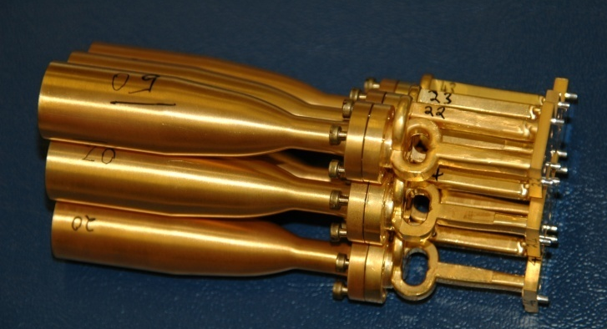
RF components development for Astronomical Instrumentation
Corrugated
horns
Aluminium
Mandrel
W-band
W-band
Mandrel
B.Maffei
Ortho-Mode Transducer (OMT)
Phase
Shifters
Equi-Phase
OMT
Filter
90° Microstrip
Hybrid
W-band
W-band
W-band
W-band
W-band
Circular Polariser
Polarimeters Array
Polarisation Modulator
Q-band
W-band

Slide 6
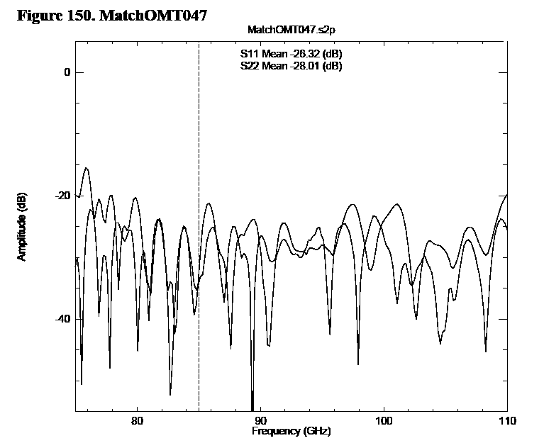
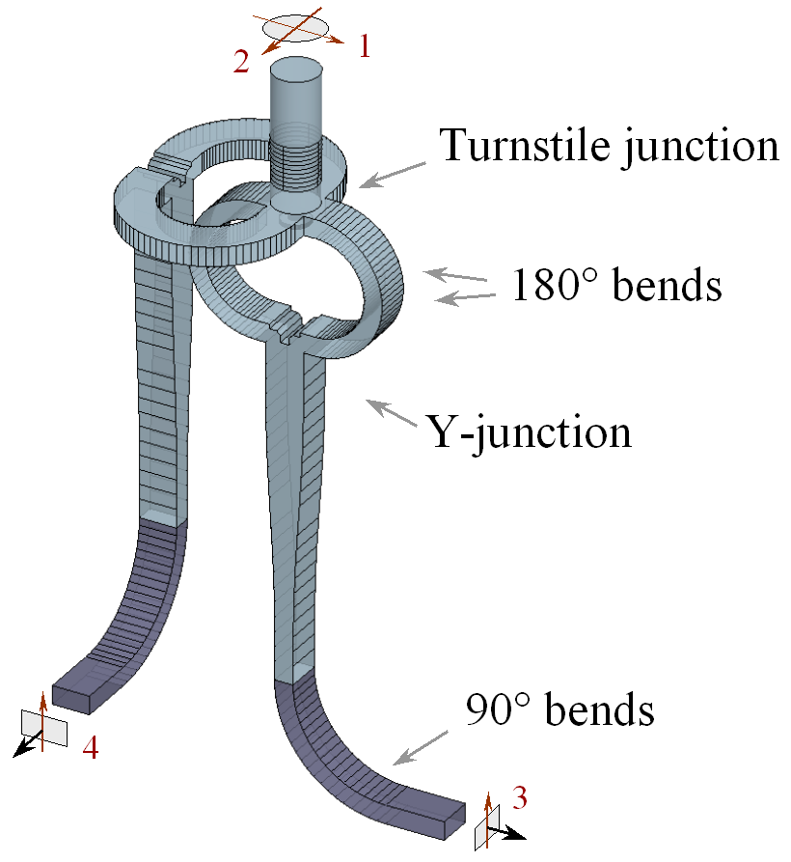
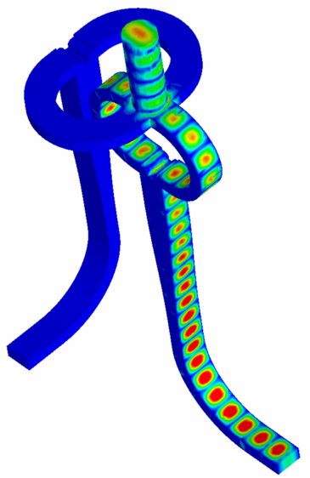
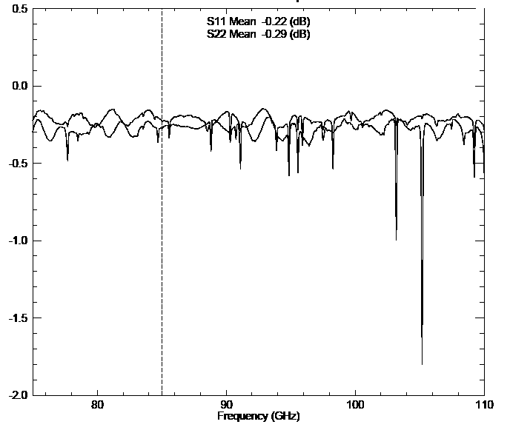
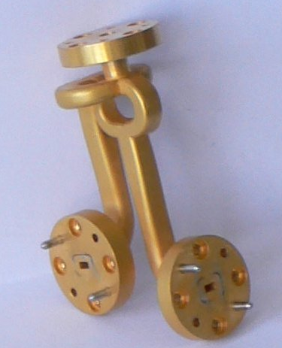
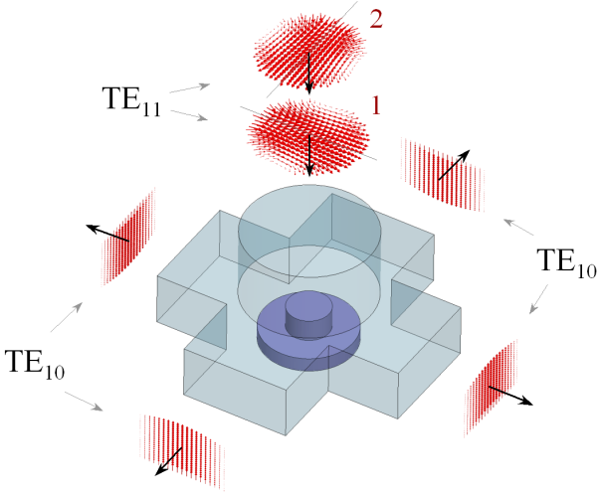
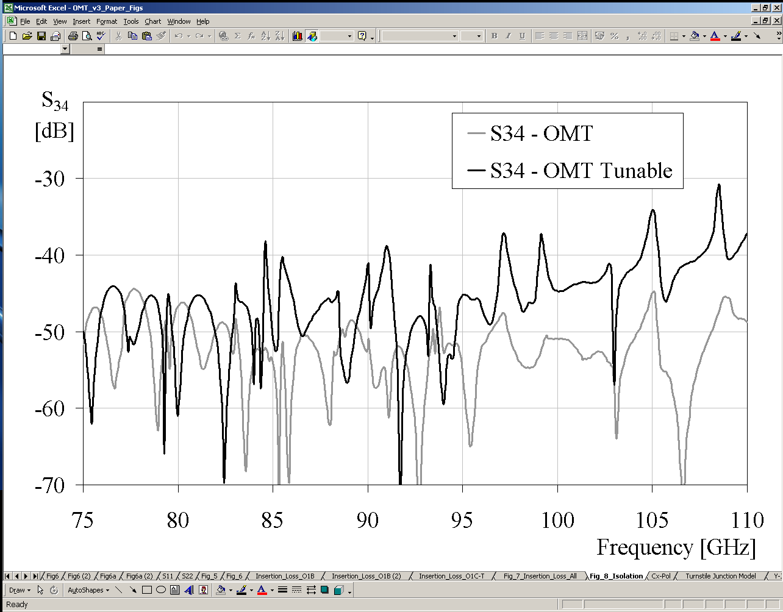
W-Band Ortho-Mode Transducer
Pisano et al. - IEEE MWCL (2007)
Return Loss ~ -26/-28 dB
OMT v.1
OMT v.2
Insertion Loss ~-0.2/-0.3 dB
OMT v.3
Cross-pol ~ -42/-50dB

Slide 7
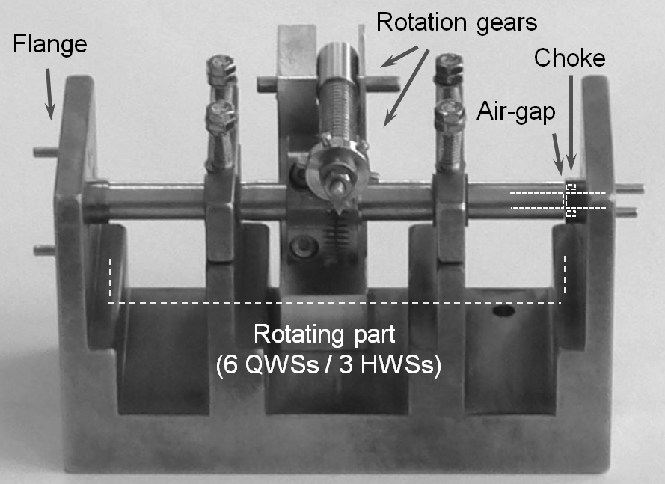
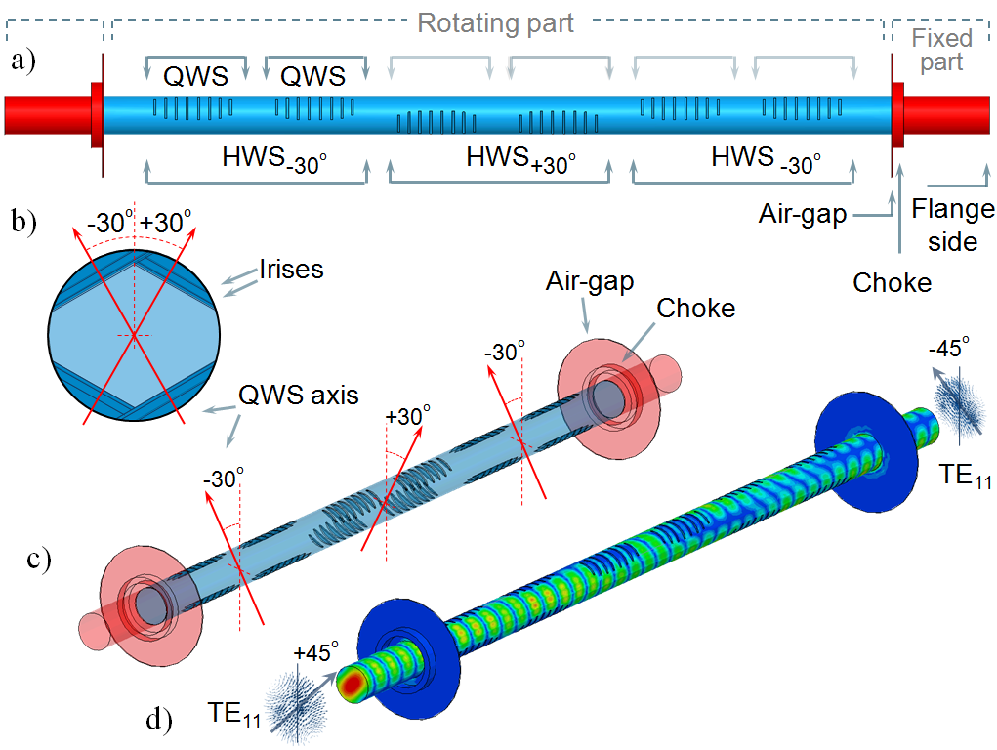
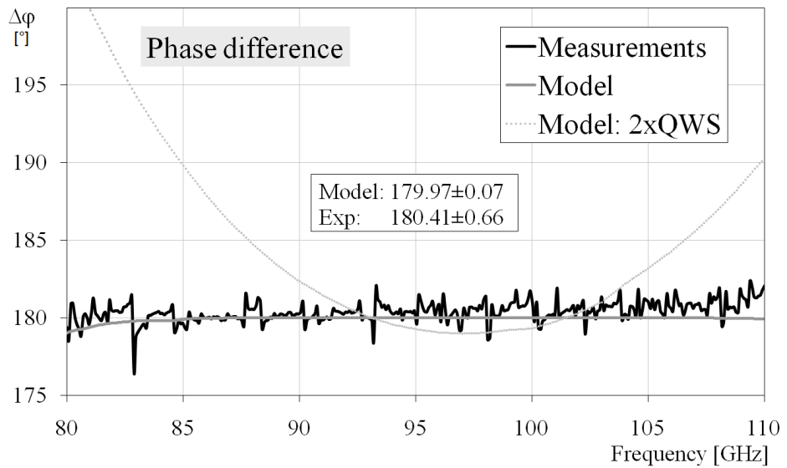
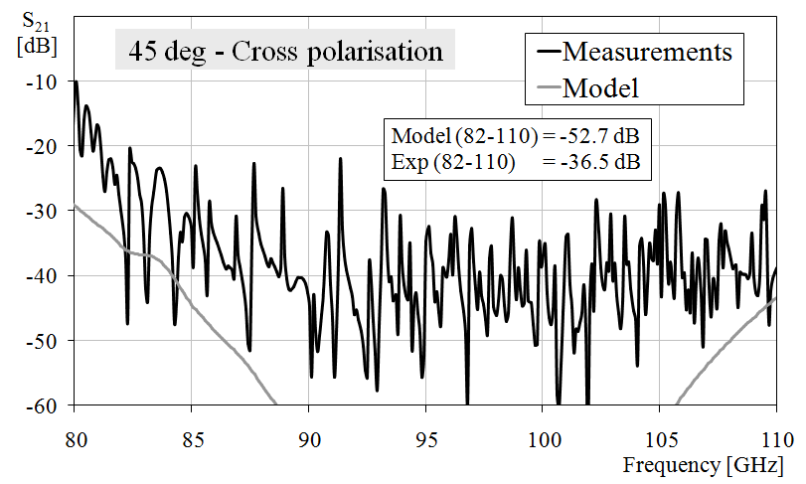
W-Band Polarisation Rotator
Pisano et al. – IEEE MWCL (2011)
- Waveguide transposition of a Pancharatnam recipe used in optics
X-pol ~ -37dB
ΔΦ < 1 deg

Slide 8
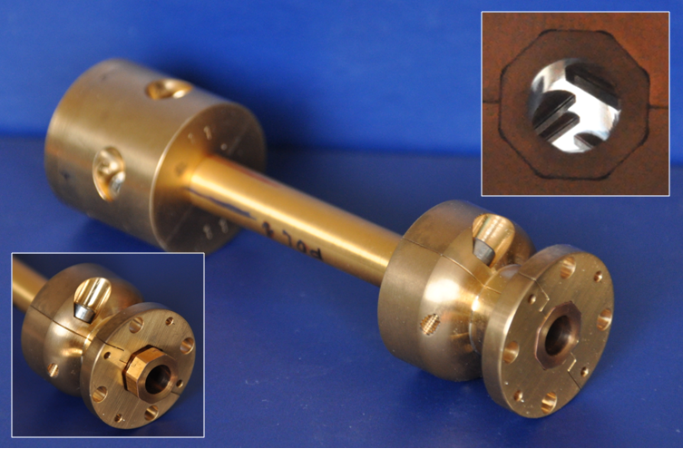
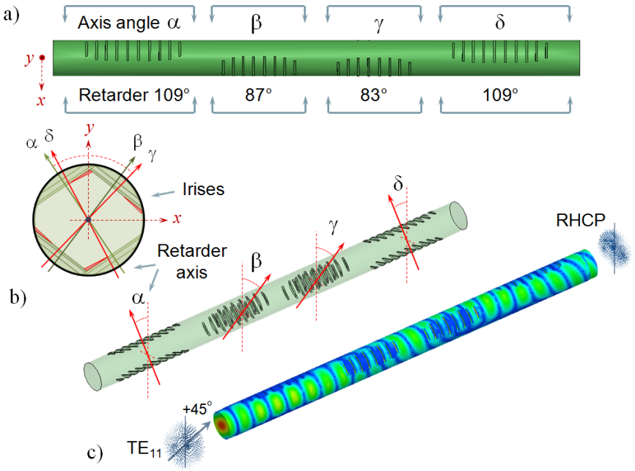
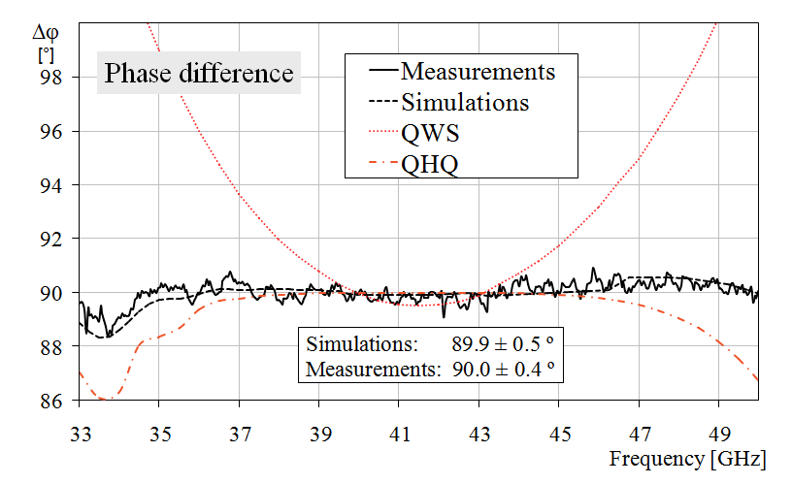
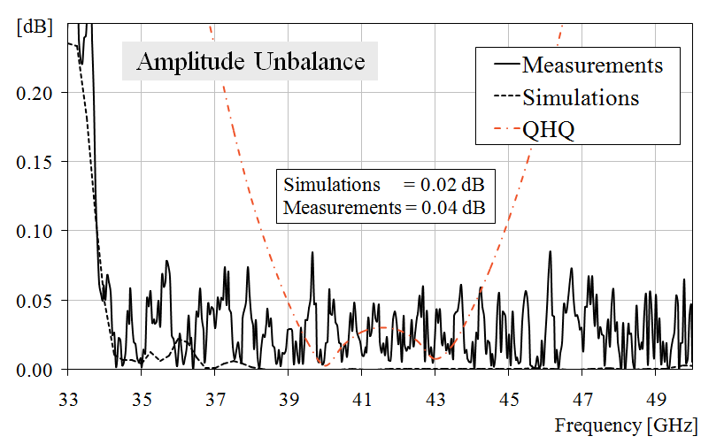
Q-Band Circular Polariser
FP7 - Apricot Project
Pisano et al. – JEMWA, v.26,
n.5/6, pp 707-715 (2012)
ΔΦ < 1 deg
AU ~ 0.04 dB
- Waveguide transposition of a Pancharatnam recipe used in optics

Slide 9
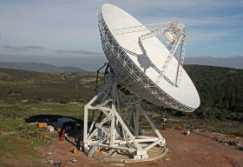
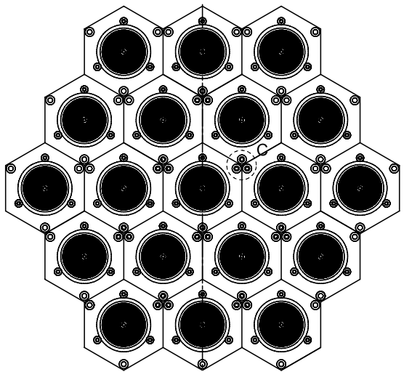
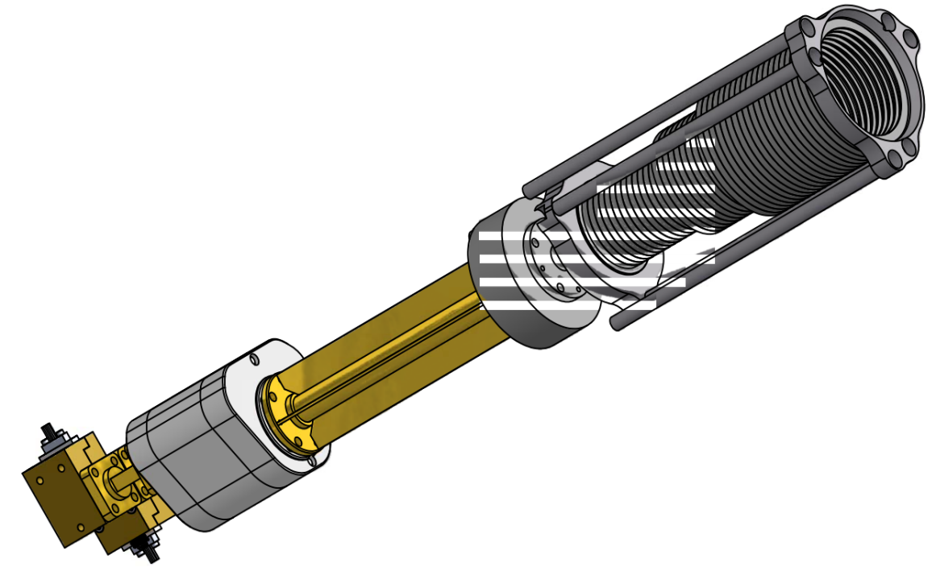
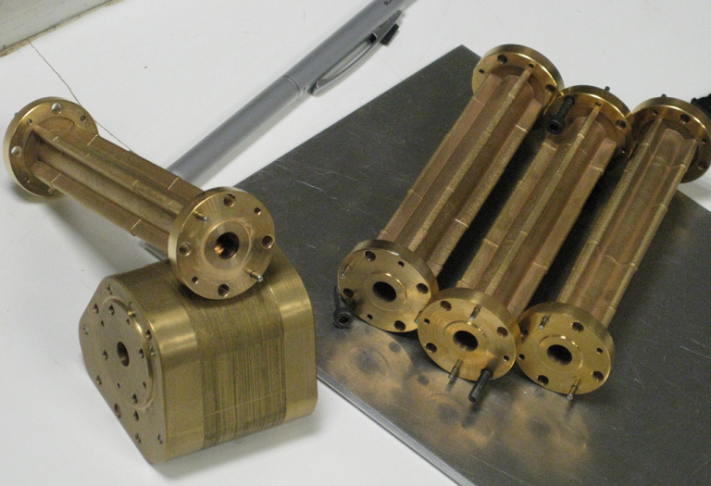
Application of the Q-band polariser: Sardinia Radio Telescope
INAF Medicina, INAF Arcetri, Cardiff University
A. Orfei
R. Nesti
P. Bolli
G. Pisano
Freq. range: 0.3 – 115 GHz
Diameter: 64m
19-beams Q-band receiver array
Platelet
Corrugated
Horn
Platelet
OMT
LNAs
Polariser

Slide 10
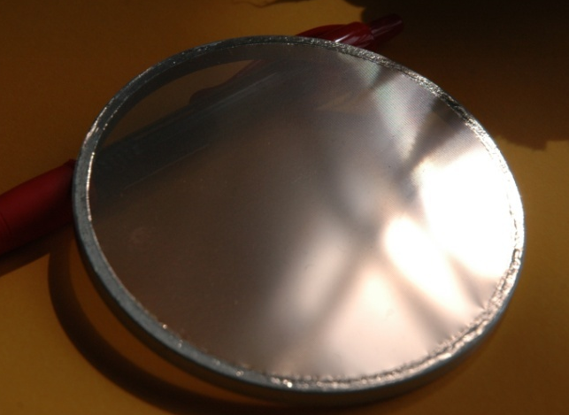
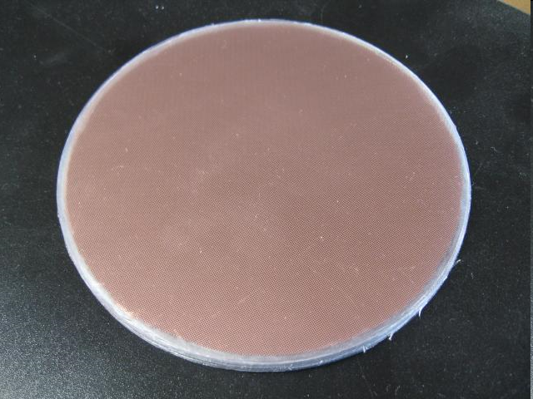
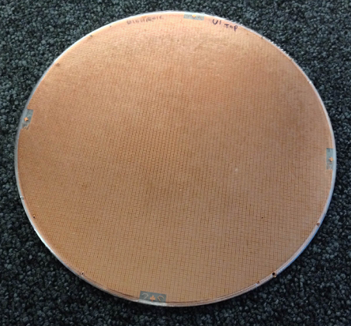
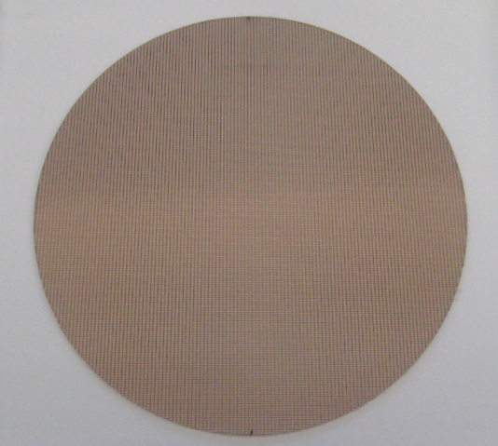
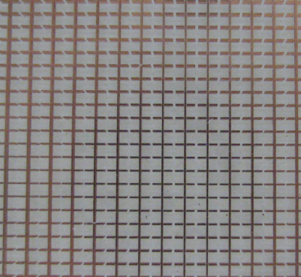
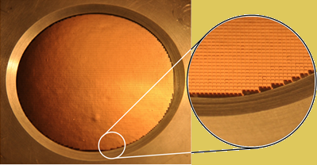
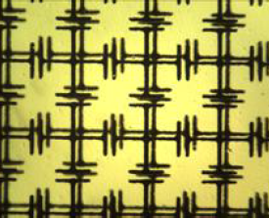
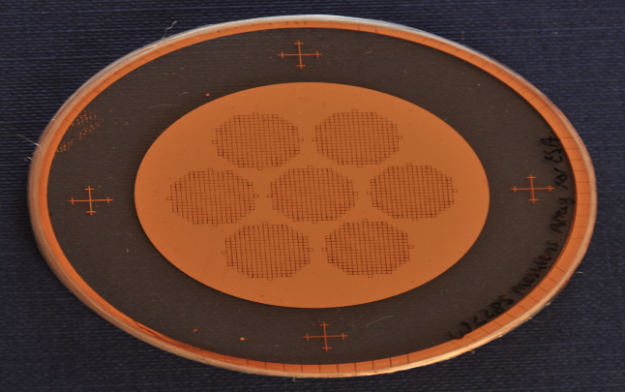
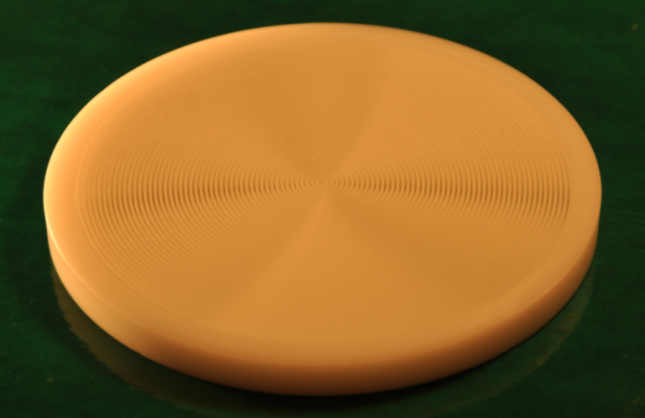
Quasi-Optical components & Metamaterials development
Photolithographic Mesh-Filters
Dielectrically Embedded Filters
Dichroics
Mesh Wave Plates
Mesh Lenses
NRI Lenses & Wave Plates
Mesh Lens arrays
OAM Q-plates

Slide 11
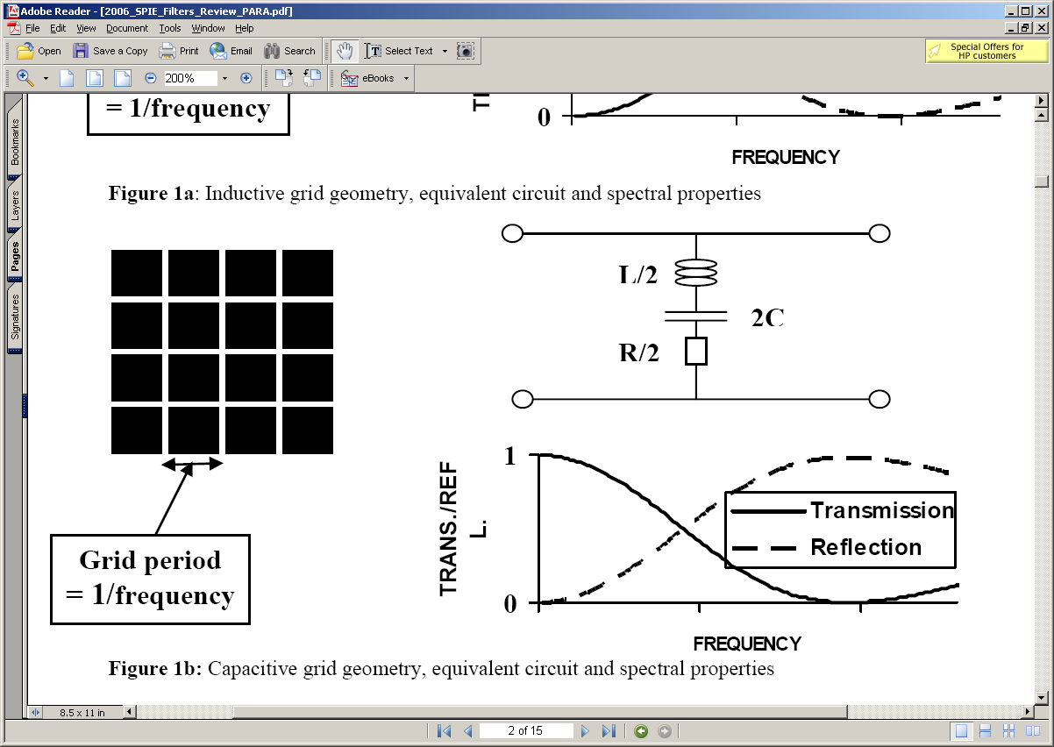
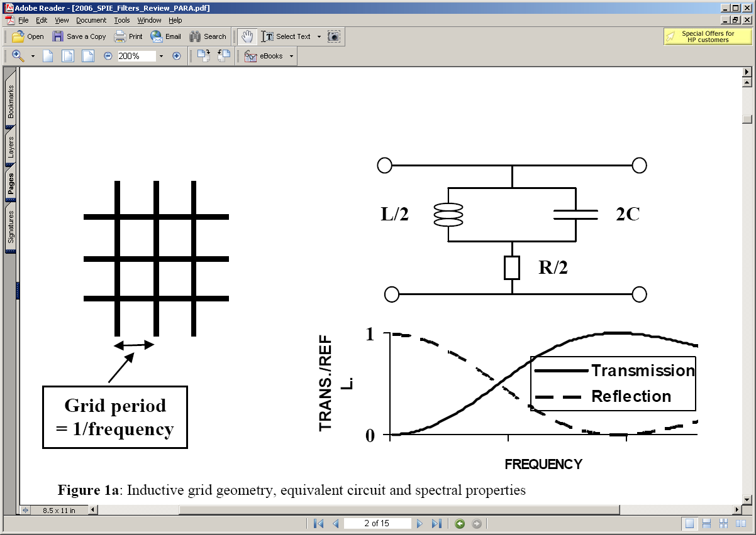
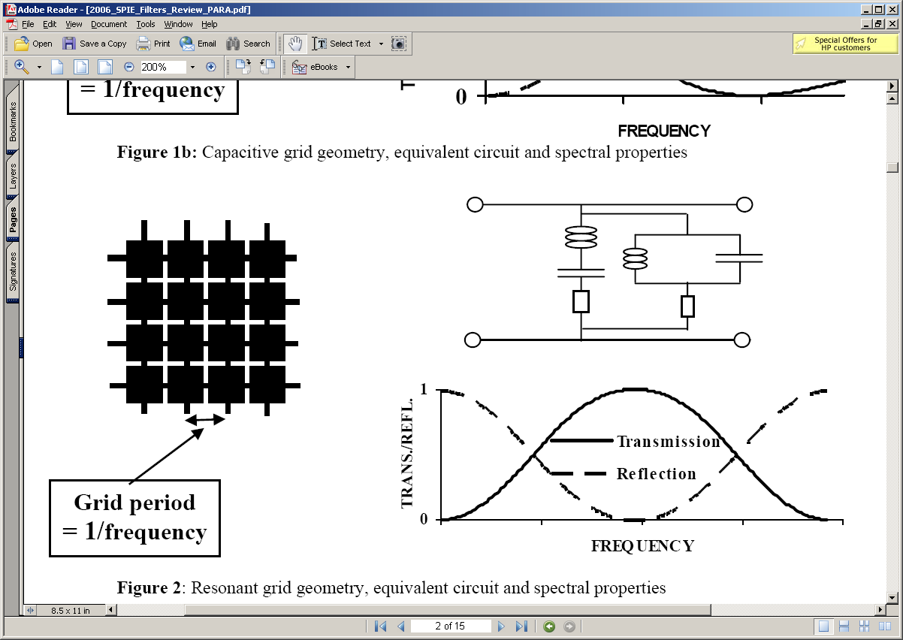
Mesh Technology: Modelling
FSSs subgroup
Markuvitz (1951)
Ulrich (1967)
Capacitive Low-Pass Filter
Sub-wavelength periodic structures
Spectral response
Grid Period
< λ
Equivalent Circuit
Inductive High-Pass Filter
Resonant Band-Pass Filter

Slide 12
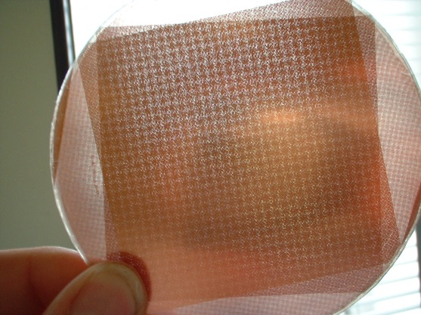
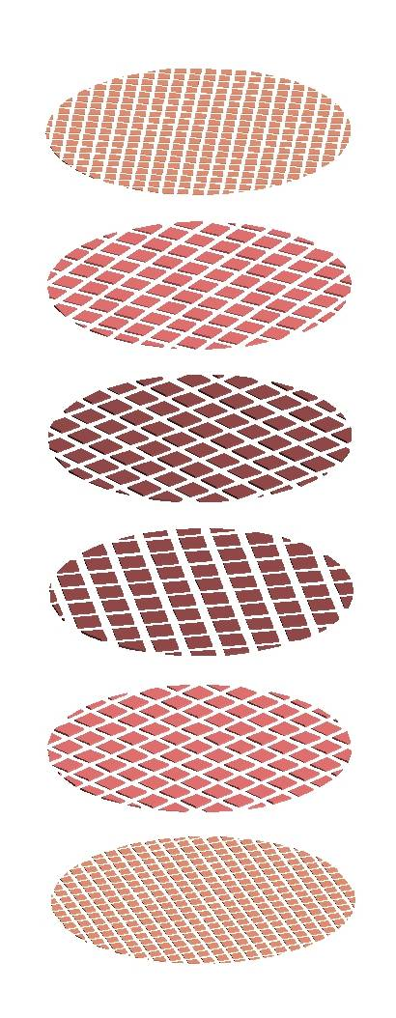

Mesh Technology: Manufacture 1/2
Free standing (air-gap) multiple metal mesh devices
Press tools
Metal grids
Filter support
rings
Spacers
The manufacturing process
Copper evaporation on polymer substrate
Photolithographic etching to form metal grid pattern
Randomly oriented grids precisely spaced and mounted together to form a single composite filter.
Air/vacuum gap filters use annular metal spacers
∅=50cm
Carole Tucker and Peter Ade
→ Large diameters achievable: 0.5m ∅

Slide 13


Mesh Technology: Manufacture 2/2
Ex: 100GHz low-pass filter
Dielectrically embedded multiple metal mesh devices
The manufacturing process
Grids production and arrangement as for air-gap filters
Polypropylene layers used as dielectric spacers
Hot pressing process to bond the whole structure together into a single device
They are robust, can be cryogenically cooled, space qualified
They can be cut to any shape

Slide 14
Mesh Filters: Band defining example
FSSs
Homogeneous
grids
Low Pass Capacitive Hot Pressed Mesh Filters (10 grids )
P.Ade, C.Tucker
- Hot pressed high frequency rejection continues through diffraction region

Slide 15
Dichroics: Frequency Splitters
P.Ade, C.Tucker
Capacitive grid air-gap with f/4 beam at 30deg incidence angle
- Essential components for multi-frequency photometers
- Allow simultaneous imaging of the source in several wavebands
- Wood’s anomalies increase with off-axis incidence angle and beam convergence

Slide 16




Mesh Half Wave Plates: First air-gap design
G. Pisano et al.
Appl.Opt. v47, n33 (2008)
Homogeneous
anisotropic
grids
Shatrow geometry
Capacitive Stack
Δϕ = π
Inductive Stack
- Rotating HWPs are used to rotate/modulate linear polarisation

Slide 17




Mesh Half Wave Plates: Embedded design
G. Pisano et al.
PIER M, 25, p101 (2012)
Homogeneous
anisotropic
grids
Lerner geometry
W-Band
Unit cell
Other devices:
QWPs (linear ↔ circular)
∅=20cm

Slide 18





Mesh HWPs: Large bandwidth designs BW~90%
Transmission along C-axis
45° Cross-Polarisation
~90% BW
Transmission along L-axis

Slide 19


Embedded Reflective HWP: Very large bandwidth BW~150%
ESA-TRP
collaboration
Cardiff Manchester
Rome
RAL
ER-HWP
y
x
0
π
Cross-polarisation
Modulation efficiency
~150% BW
- Metamaterial based reflecting devices working up to 45 deg incidence angles

Slide 20


Flat Mesh Lens: Inhomogeneous Phase Delays
G. Pisano et al.
Applied Optics 52,n.11, (2013)
Locally variable
grid geometries
Inhomogeneous
grids
Multiple transmission lines
54 mm Ø
- Very thin and robust
- Very light and low loss
- No Anti Reflection Coatings required
W-Band f/3 lens prototype (1.4mm thick)

Slide 21



Flat Mesh Lens: Transmission line design
G. Pisano et al.
Applied Optics 52,n.11, (2013)
- Lens consisting of ~ 8000 TLs
- Solution of just 1/8 of the surface
- Optimisation for max transmission &
appropriate differential phase shift
Flat lens made with 10 grids (5+5)

Slide 22


Flat Mesh Lens: Finite-element modelling
G. Pisano et al.
Applied Optics 52,n.11, (2013)
2D model (cylindrical)
Central TL array
3D full model

Slide 23



Flat Mesh Lens: VNA beam tests
G. Pisano et al.
Applied Optics 52,n.11, (2013)
→ Experimental agreement down to the 4th side lobes

Slide 24


Flat Mesh Lens Array: Focal plane detector/antenna integration
ESA TRP collaboration: Maynooth (PI), Manchester, Cardiff, Rome, Paris APC and Chalmers
W-band
10 mm
- Mesh lens miniaturisation for large focal plane arrays
- Usual manufacturing processes, accurate alignment required
- A single flat device includes all the lenses

Slide 25
Mesh-based QO devices
- We have discussed only a few devices developed using the mesh technology
Filters
Retarders
Flat lenses
- Low pass & high pass
- Band pass
- Blocking filters
- Neutral density
- Mesh HWP
- Mesh QWP (circ.polariser)
- Reflective HWP
- Spiral Phase Plate
- Graded index lens
- Mesh lens
- Mesh lens array
- Negative index lens
Dividers
Metamaterials
- Beam divider
- Dichroic
- Polariser
- Polarisation splitter
- Mesh Prism
- Artificial dielectrics
- Artificial birefringent materials
- Anti-Reflection Coatings (ARCs)
- Negative Index metamaterials
- Artificial Magnetic Conductors
- Mesh Absorbers
- Many of these are standard solutions adopted in mm-wave and THz
astronomical instrumentation
- Some of the most recent solutions are currently finding their applications
- More ‘exotic’ devices are currently under development..

Slide 26

Mesh Trichroic for triple-feed simultaneity: Conceptual idea
- Can we design a mesh-device able to redirect beams at different frequencies?
x=d
See A.Orfei Talk:
“Multi-frequency observations
using multifeed systems”
Same mesh recipe
for fixed x
Δϑ
α
Δϑ
ν₁
ν₂
ν₃
ν
−α
ν₃
Δν₁
Δν₂
Δν₃
x=0
ν₂
ν₁
- It’s not a focusing component
- It’s re-directing radiation in different directions depending on frequency
- Same direction within same bands
→ Design of highly transmissive ‘mesh-filters lines’ with complex phase behaviour

Slide 27





Mesh Trichroic for triple-feed simultaneity: Conceptual idea
ν₁ ± Δν₁
ν₂ ± Δν₂
ν₃ ± Δν₃
- The frequency-dependent differential phase-shift, respect to a fixed point
(ex: centre), would create the required off-axis phase-fronts at the output
- Real converging beams will require additional optimisation
→ This is an ongoing development

Slide 28
Conclusions
Waveguide development:
  Alternative designs based on recipes used in optics
Metamaterial mesh-devices development:
  Very broad range of components available
  Very accurate modelling, manufacture and testing now achievable
New exotic mesh-devices:
  Local, frequency dependent arbitrary manipulation of :
    Transmitted/reflected amplitudes
    Transmitted/reflected phases
    Polarisation states
    ‘Equivalent’ refractive index and dispersion
    ‘Equivalent’ birefringence

Slide 29
The End
Thank you!

